Slide 1

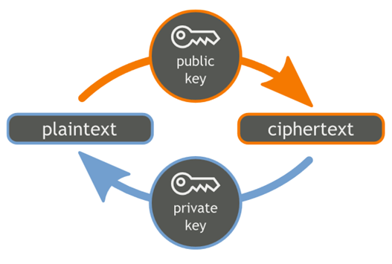

Asymmetric Key Ciphers and RSA
RSA
Public Key Cryptosystems & RSA

Slide 2
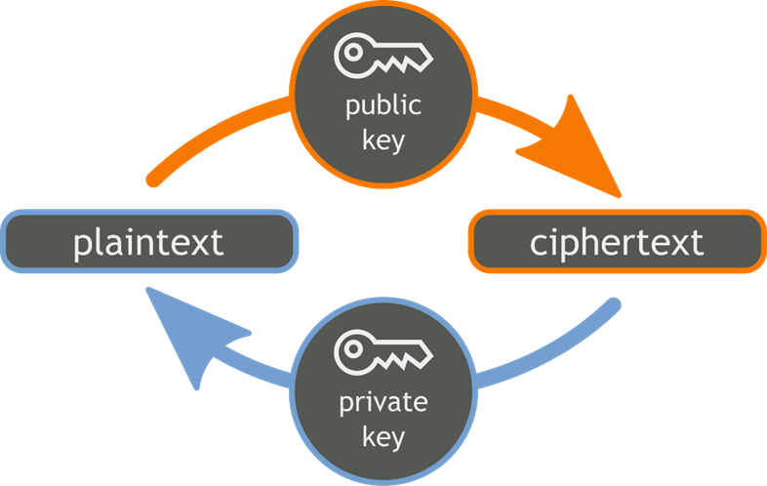
Asymmetric Key Ciphers
Asymmetric key ciphers
Use two different keys to encrypt and decrypt data
Encryption key + decryption key
Asymmetric cryptosystems – use cases and algorithms:
Digital signatures – RSA, ECDSA, EdDSA , EIGamal
Encrypt / decrypt messages – DLIES, ECIES

Slide 3
RSA Cryptography
RSA (Rivest–Shamir–Adleman) is public-key cryptosystem
Based on big integers and modular exponentiation
Developed by MIT, widely used in computer cryptography
Generate RSA public / private key pair
Find very large integers e, d and n, such that:
(m^{e})^{d} ≡ m (mod n) for all m for 0 ≤ m < n
public key = {n, e} → shared with everyone
private key = {n, d} → secret, cannot be calculated from {n, e}

Slide 4


RSA Cryptography: Encrypt / Decrypt
Encrypt a message with RSA public key {n, e}
encrypted = (message)^{e} mod n
Decrypt a message with RSA private key {n, d}
message = (encrypted)^{d} mod n
Recall that (m^{e})^{d} ≡ m (mod n)
No efficient algorithm exists for integer factorization
If you are given n, you cannot find its factorization n = p*q
No efficient algorithm to calculate {n, d} from {n, e}

Slide 5
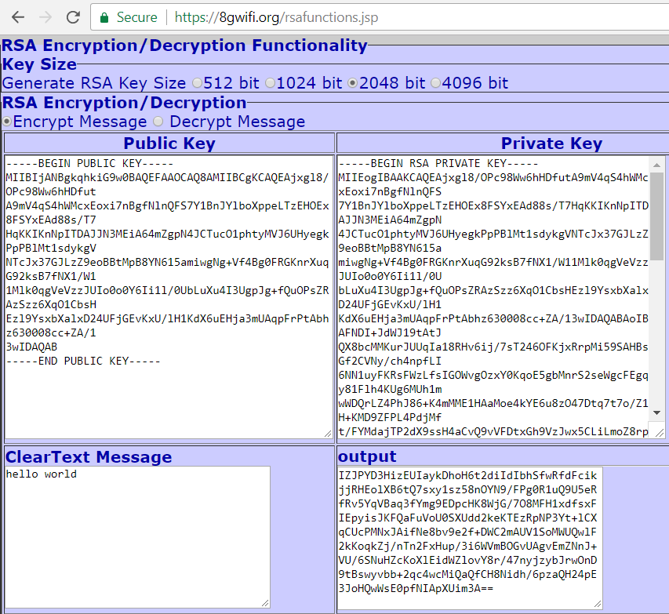
RSA Encrypt and Decrypt
Live Demo
https://8gwifi.org/rsafunctions.jsp

Slide 6

Asymmetric Key Ciphers and RSA
Try the Demo!

